Slide 1
MySQL
Download/Installation Guide

Slide 2

Downloading MySQL

Slide 3
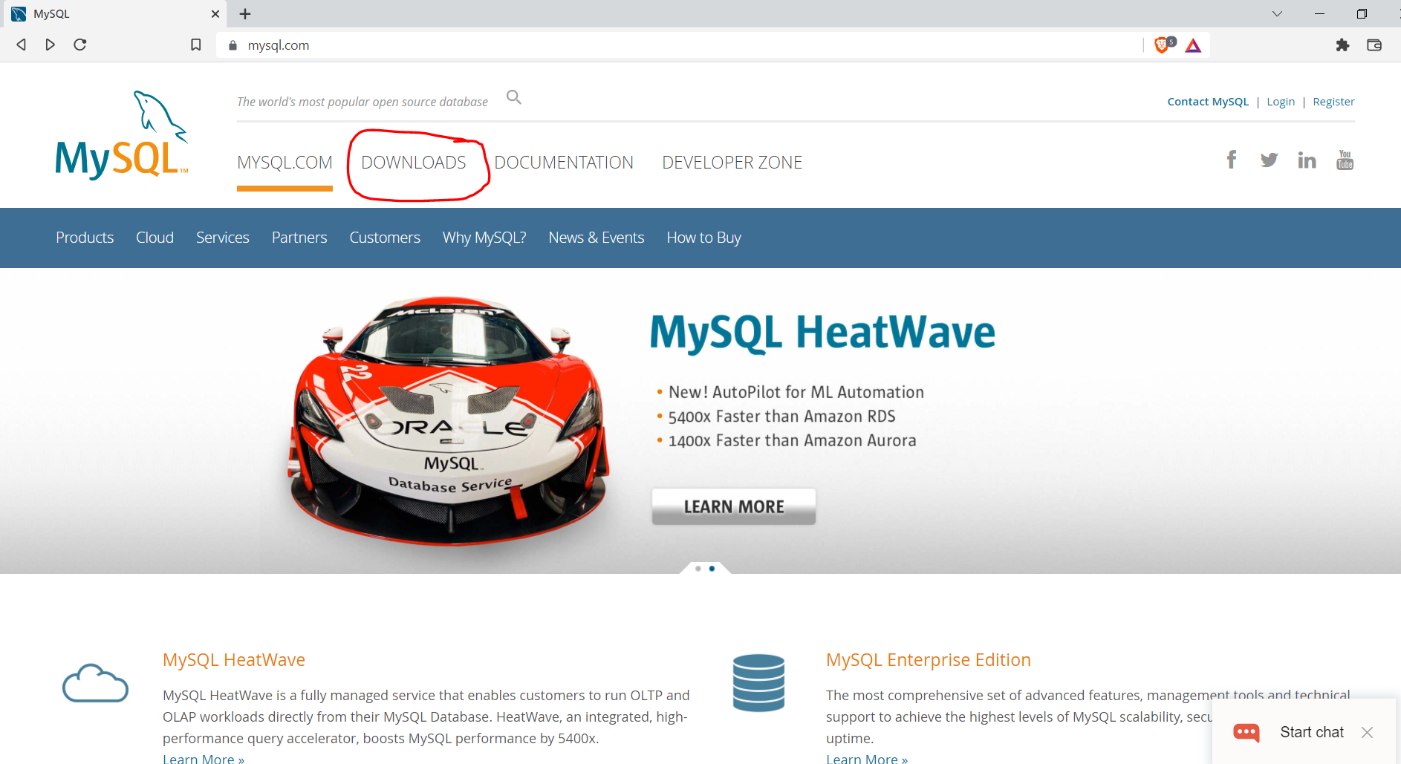
> Go to mysql.com

Slide 4
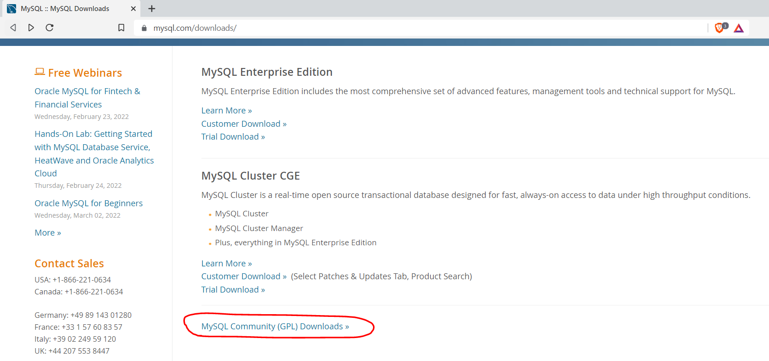
> Scroll down to bottom in downloads page > Click on: MySQL Community (GPL) Downloads

Slide 5
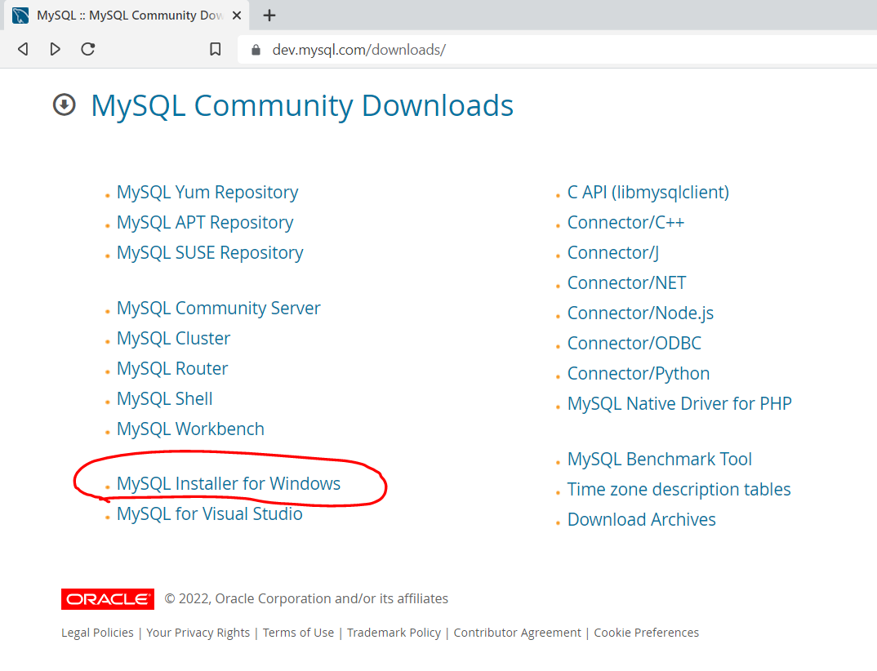
> Click on: MySQL Installer for Windows

Slide 6
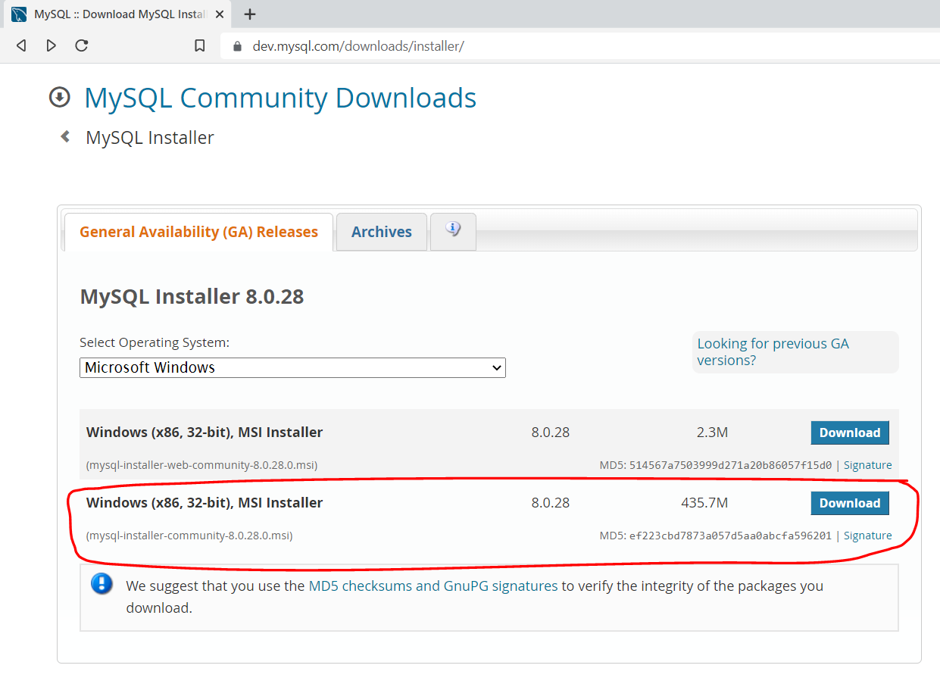
> Click Download on the below circled installer

Slide 7
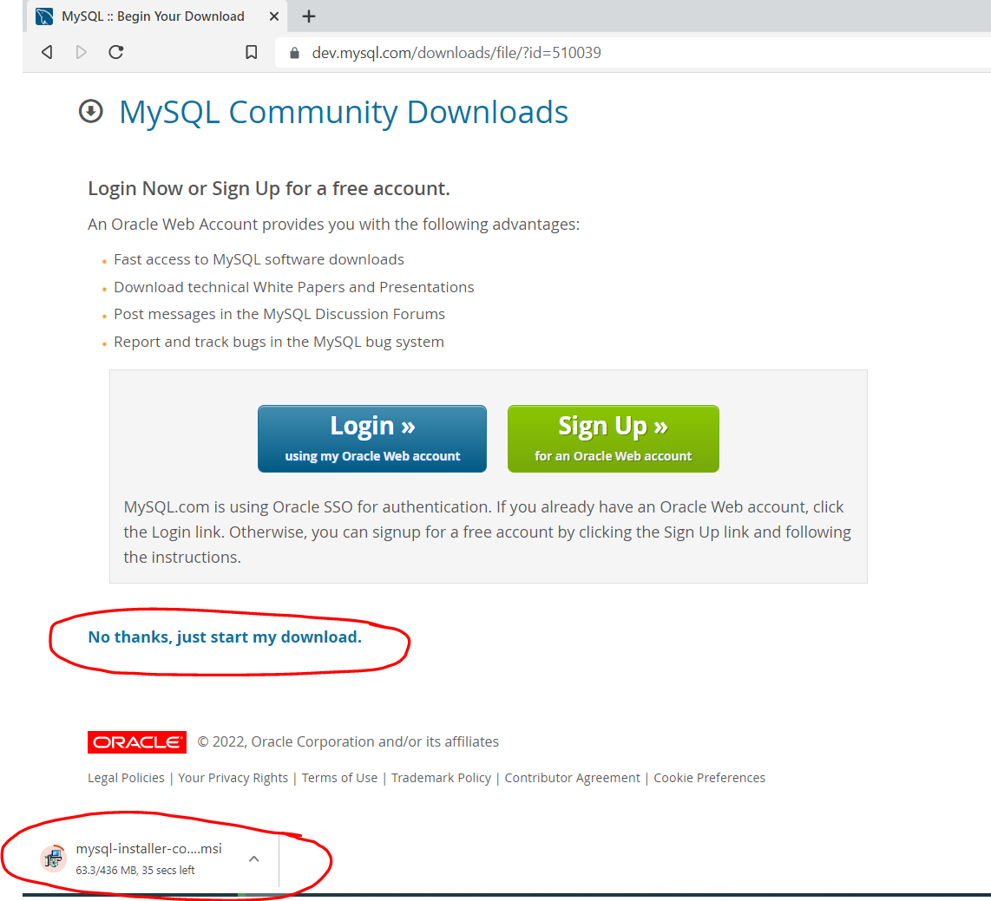
> Click: No thanks, just start my download

Slide 8

Installing MySQL

Slide 9
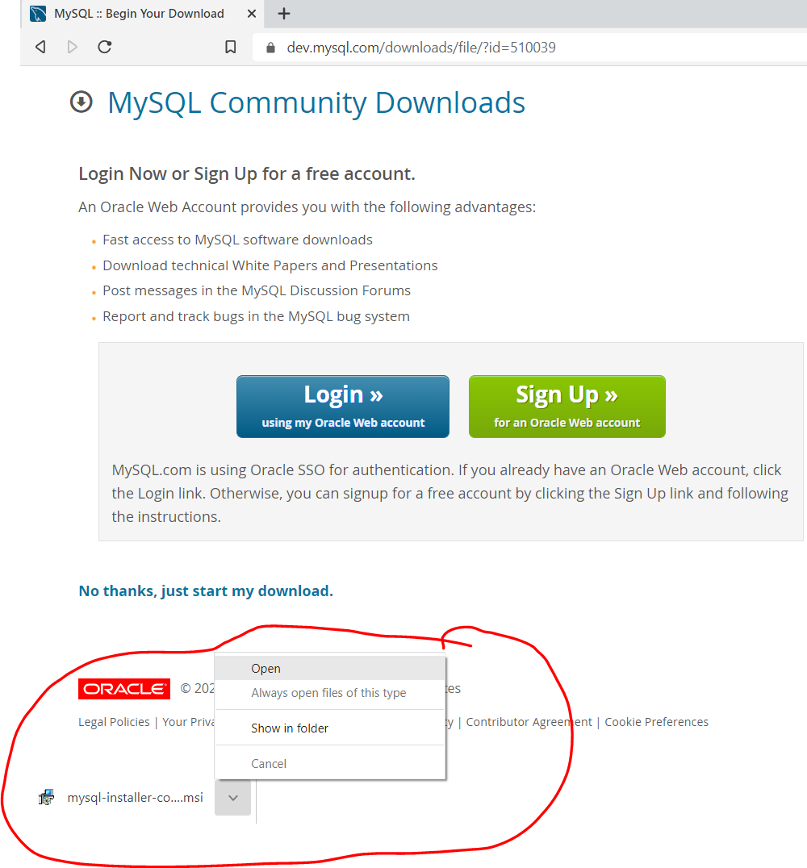
>Open the downloaded installer

Slide 10
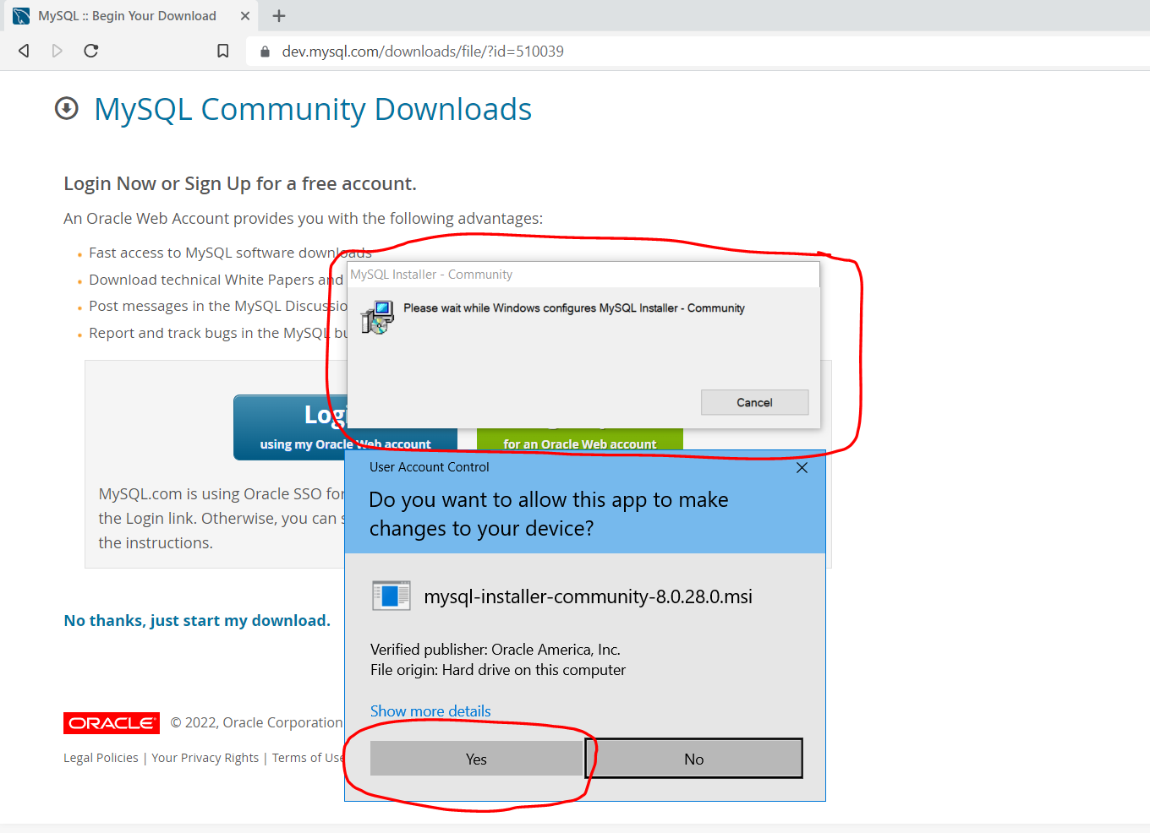
> Allow all the windows popups you get

Slide 11
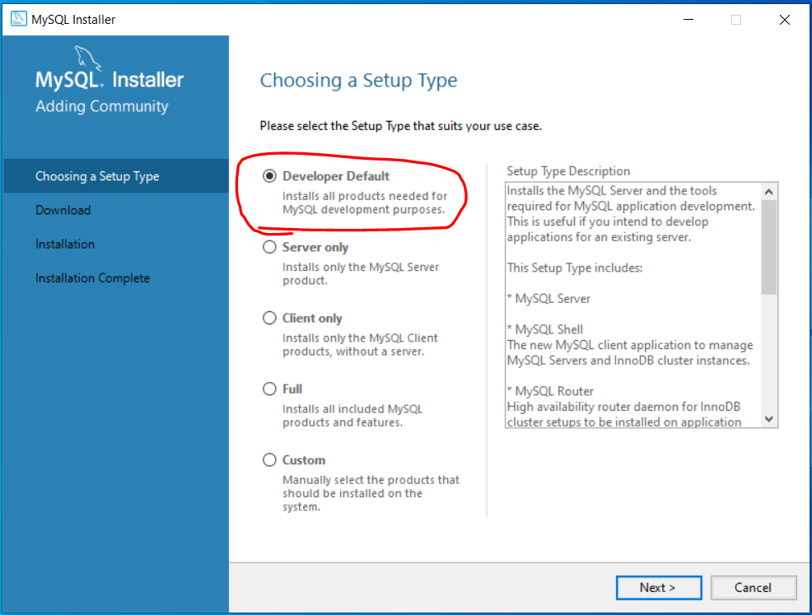
>Use Developer Default as Setup Type

Slide 12
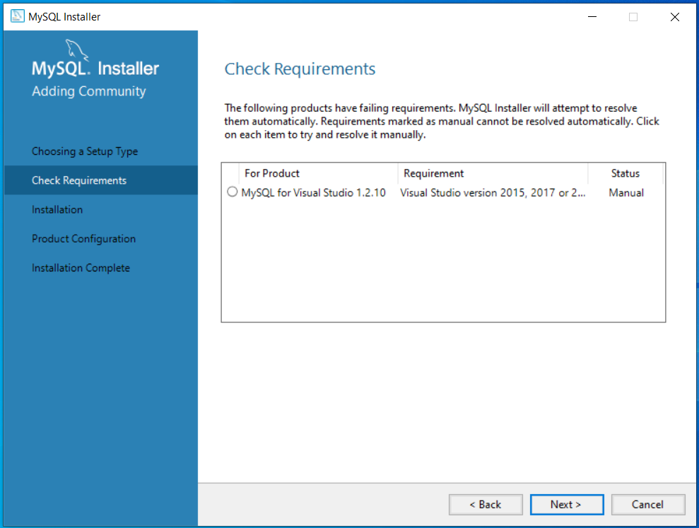
>Click Next on Check Requirements page

Slide 13
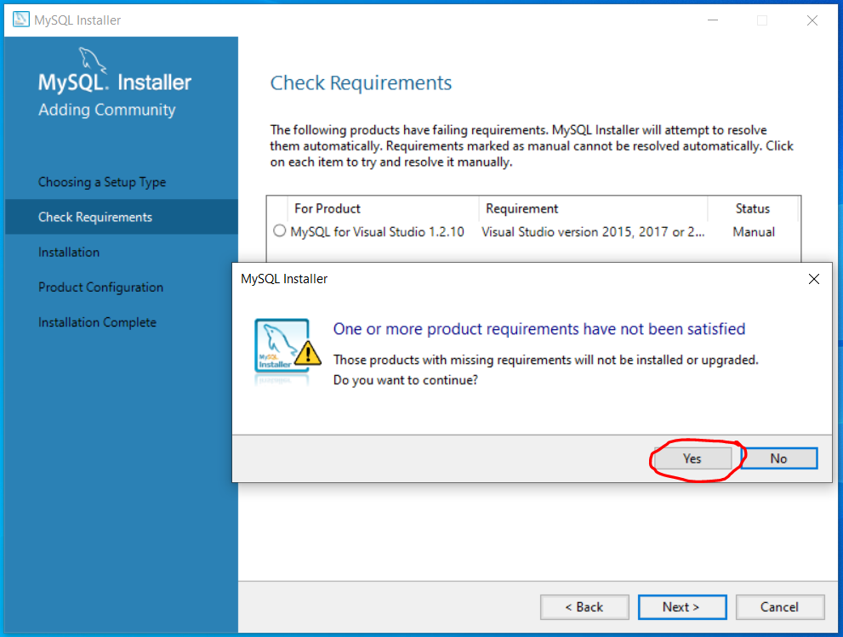
>Allow popups and continue

Slide 14
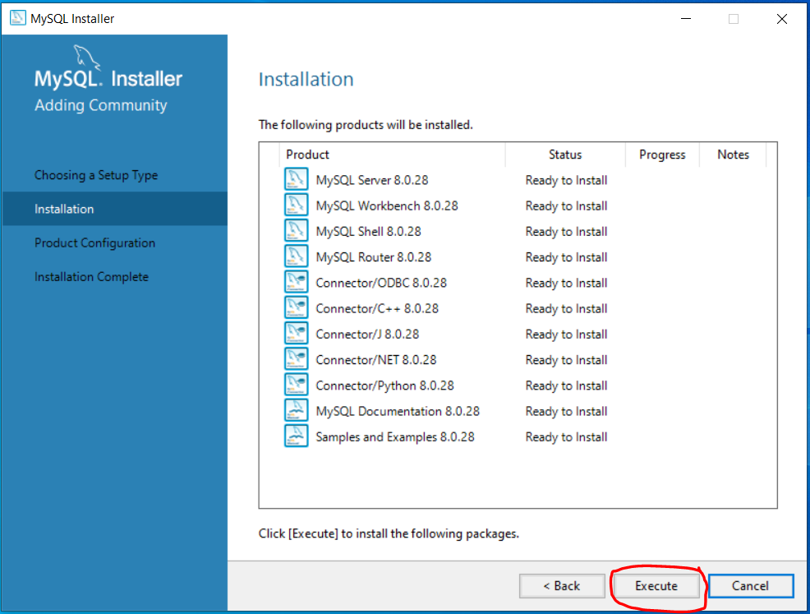
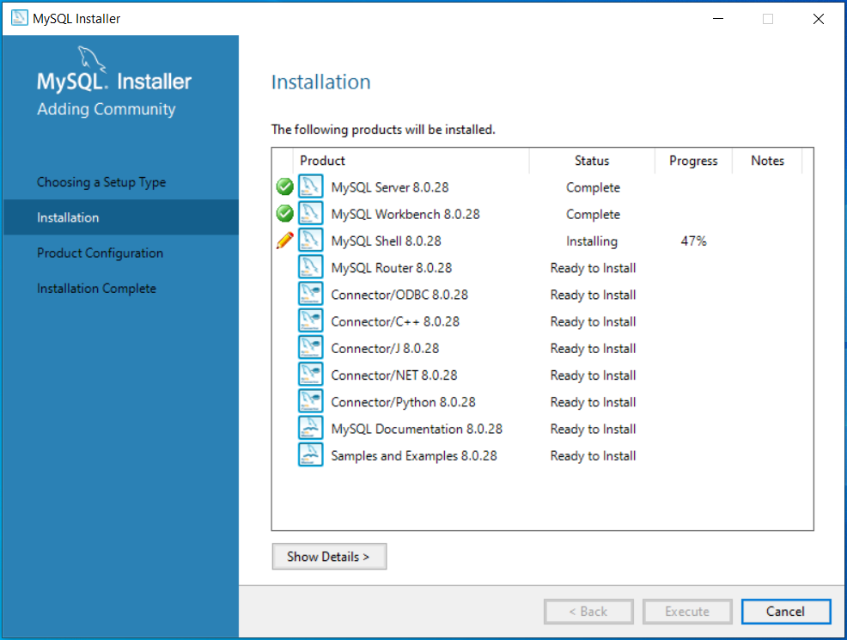
Click: Execute to start installation

Slide 15
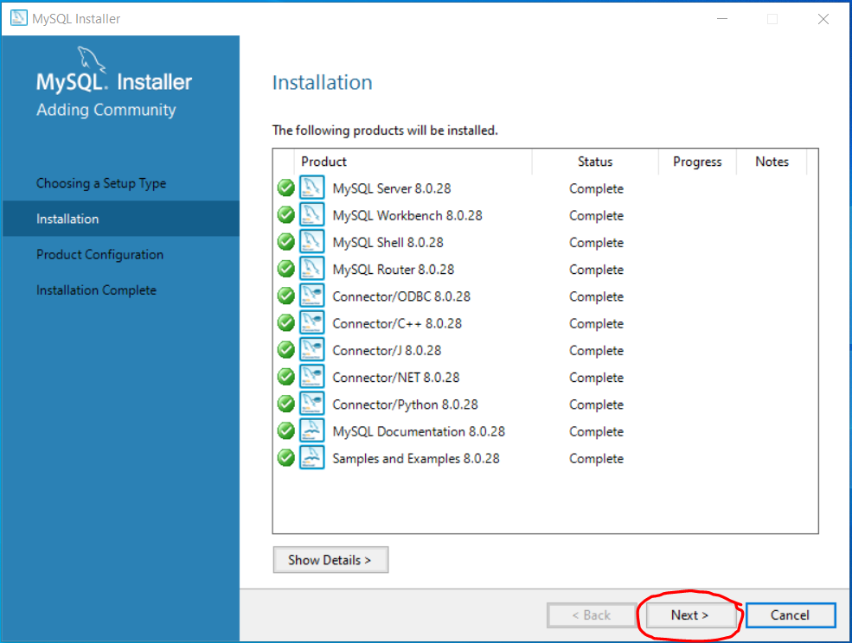
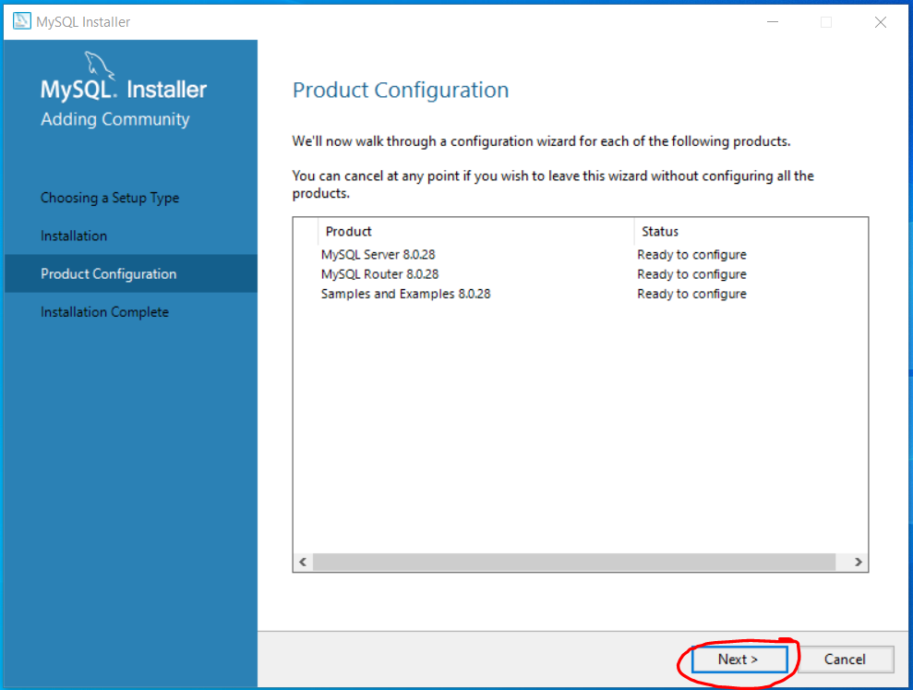
>Click next when installation is done and next on Product Configuration page

Slide 16
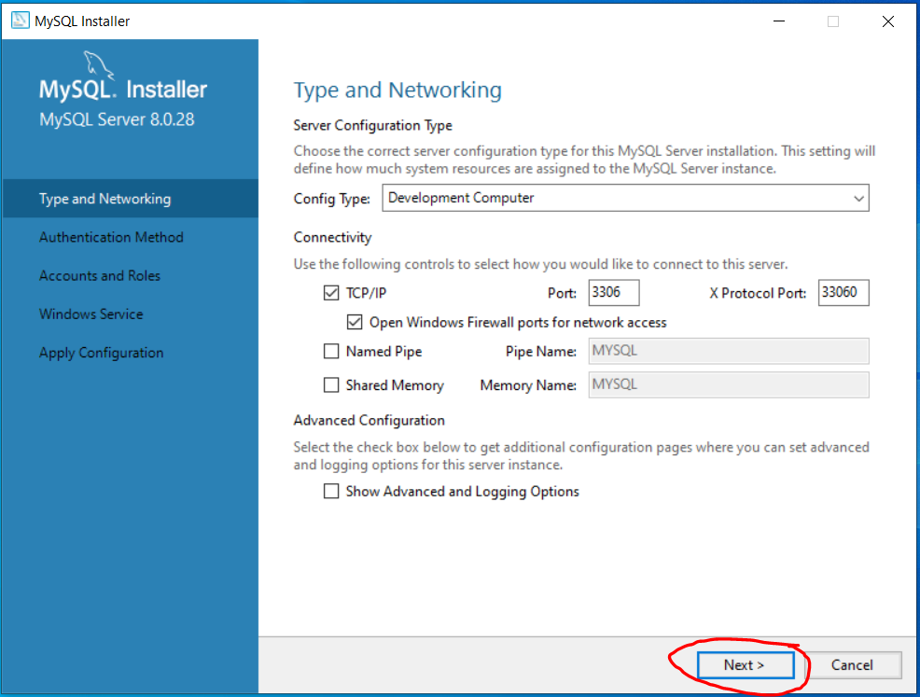
>Leave the default values as it is under Type and Networking and click next

Slide 17
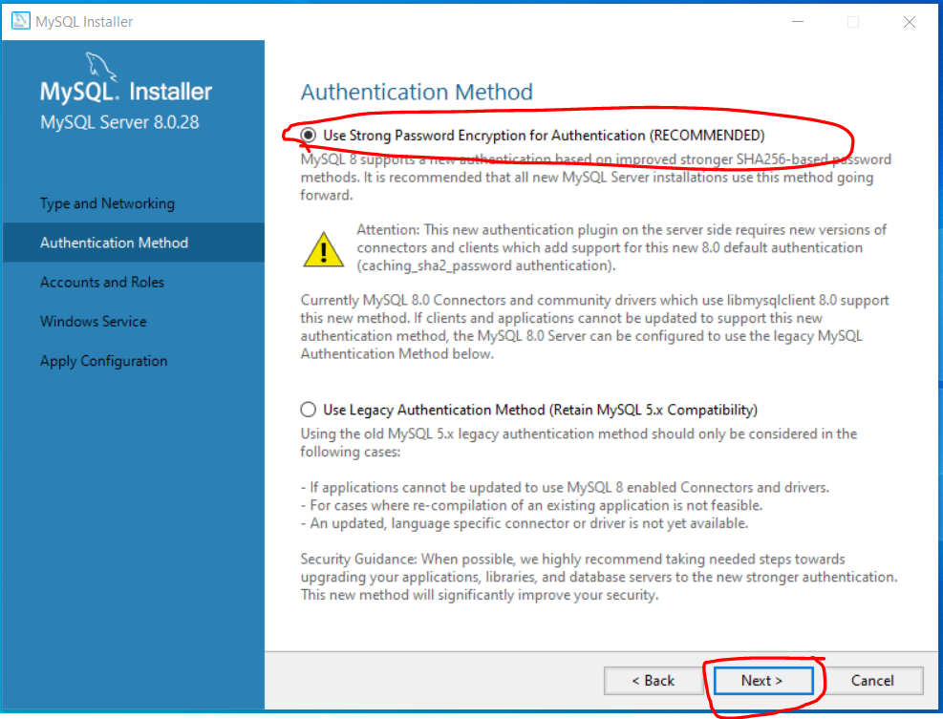
>Use the default recommended Authentication Method and click next

Slide 18
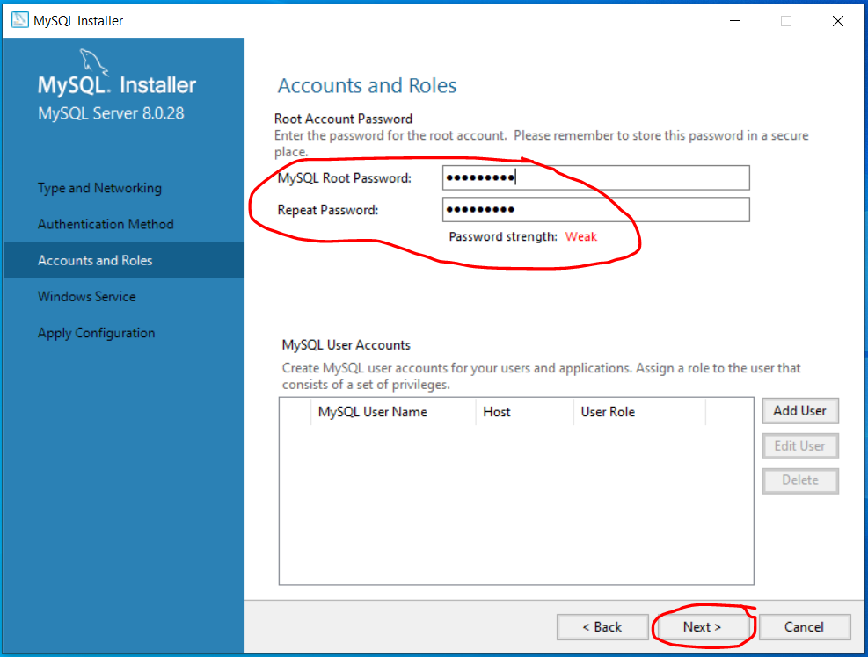
>Set password of your choice and click next

Slide 19
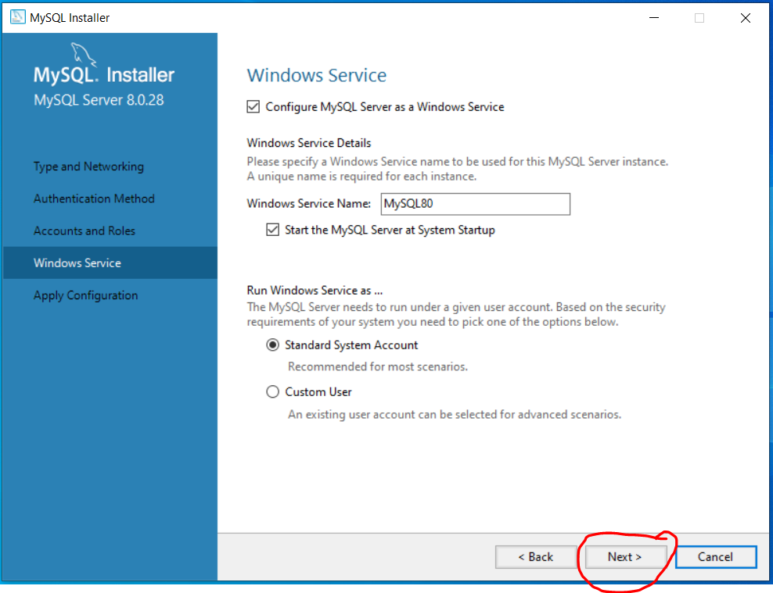
>Leave the default values as it is in Windows Services and click next

Slide 20
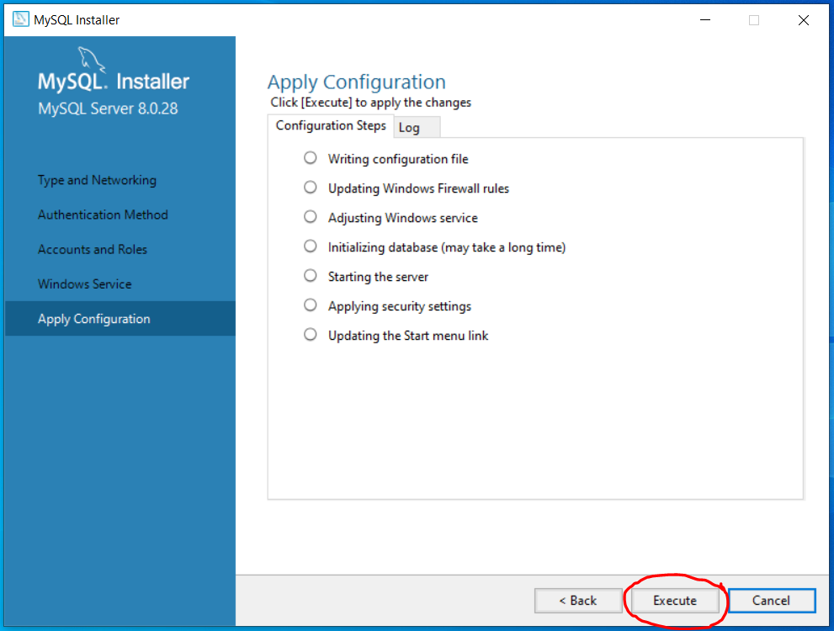
>Click Execute in Apply Configuration page

Slide 21
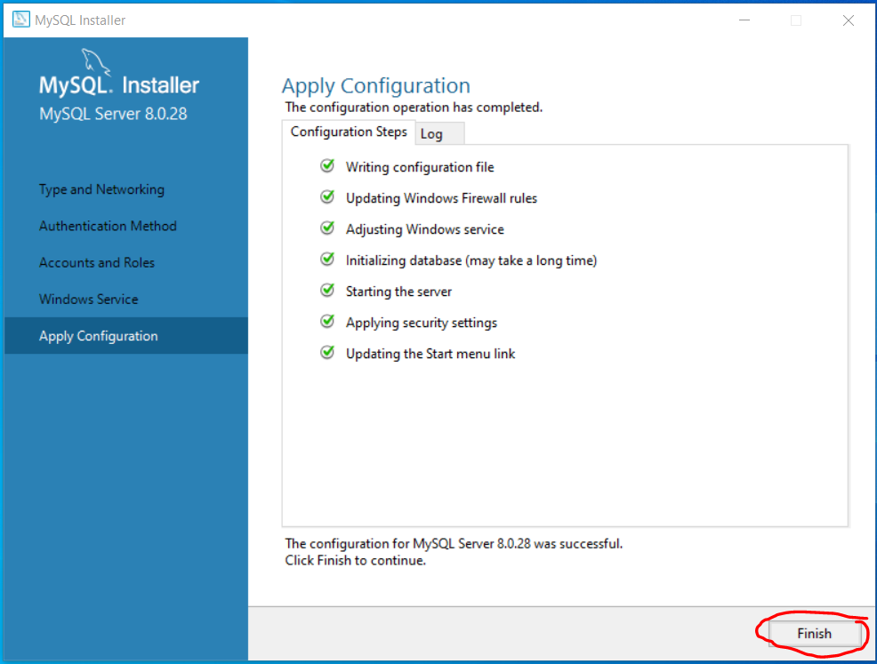
>Click finish to complete the configuration of MySQL Server

Slide 22
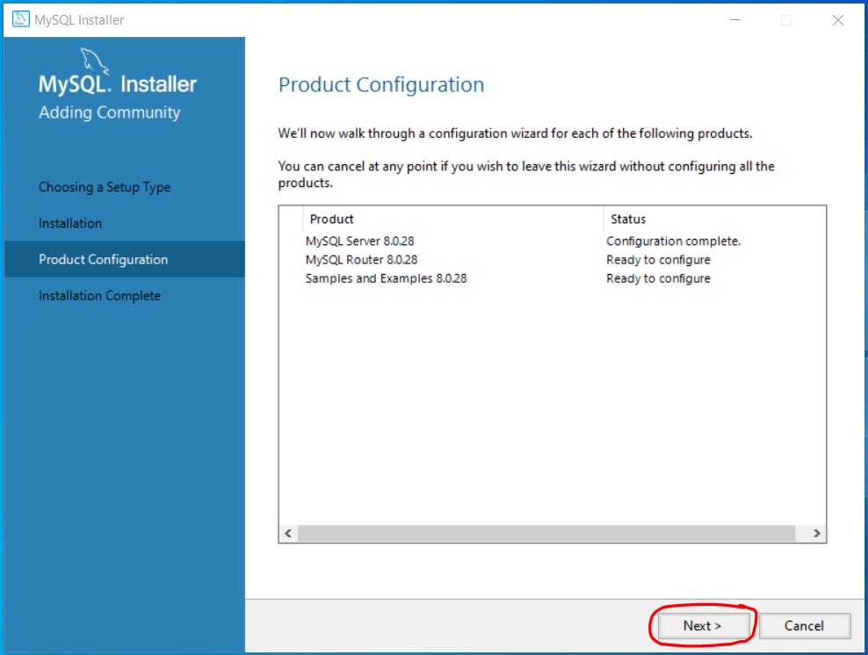
>Click Next on Product Configuration page

Slide 23
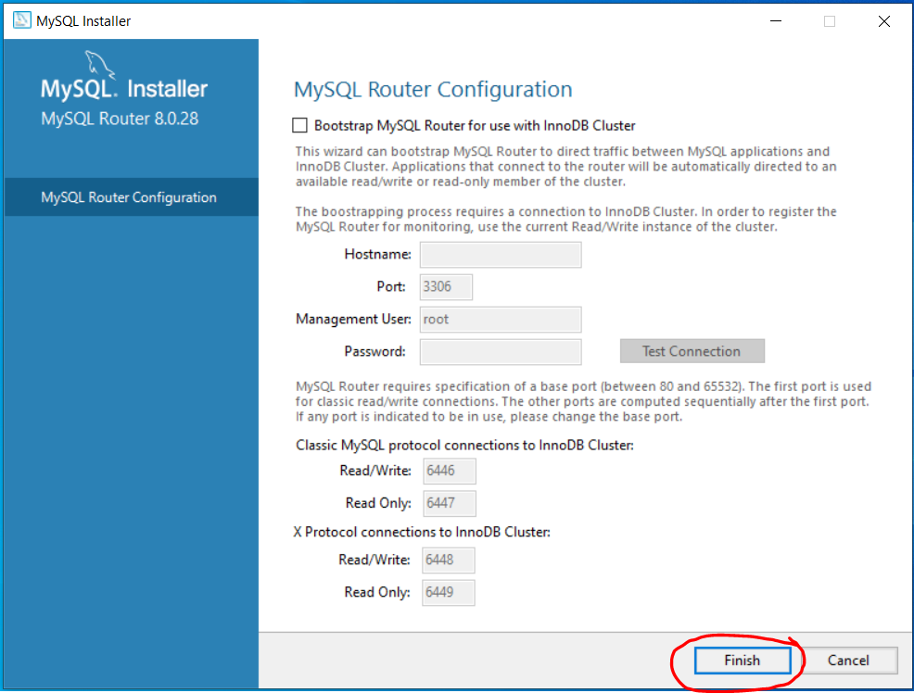
>Click Finish on Router Configuration page

Slide 24

>Click Next on Product Configuration page

Slide 25
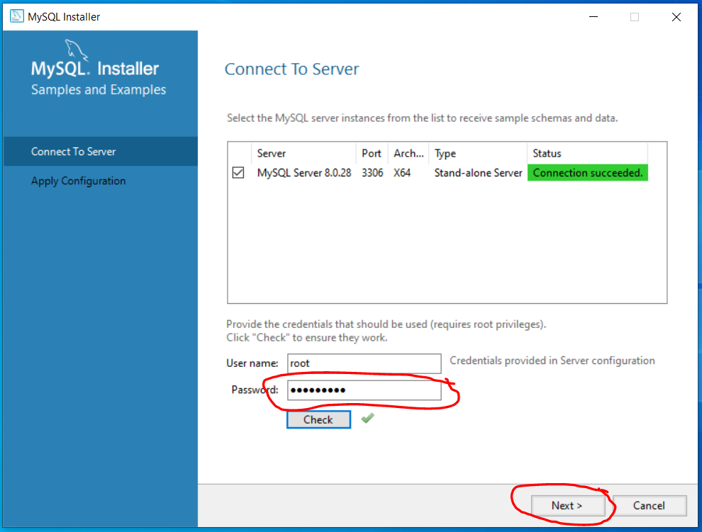
>Enter the password you created in previous step and check >Click Next when connection is successful

Slide 26
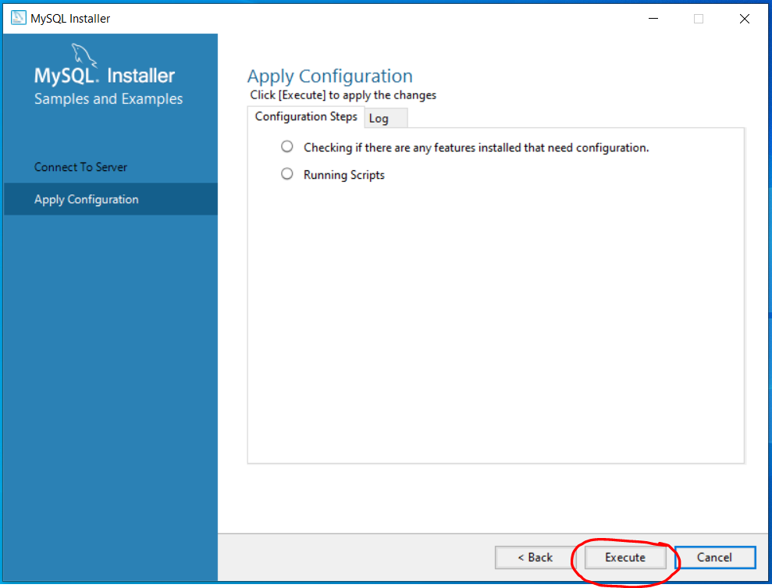
>Click Execute on Apply Configuration page

Slide 27
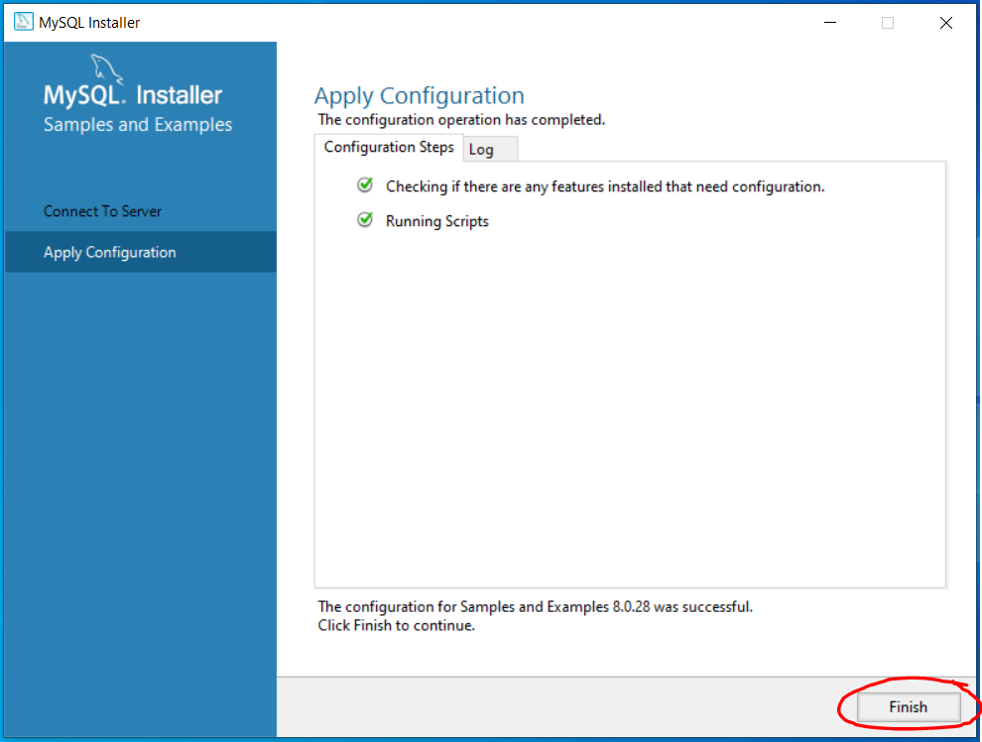
>Click Finish on Apply Configuration page

Slide 28

>Click Next on Product Configuration page >You can see the products configuration is now complete

Slide 29
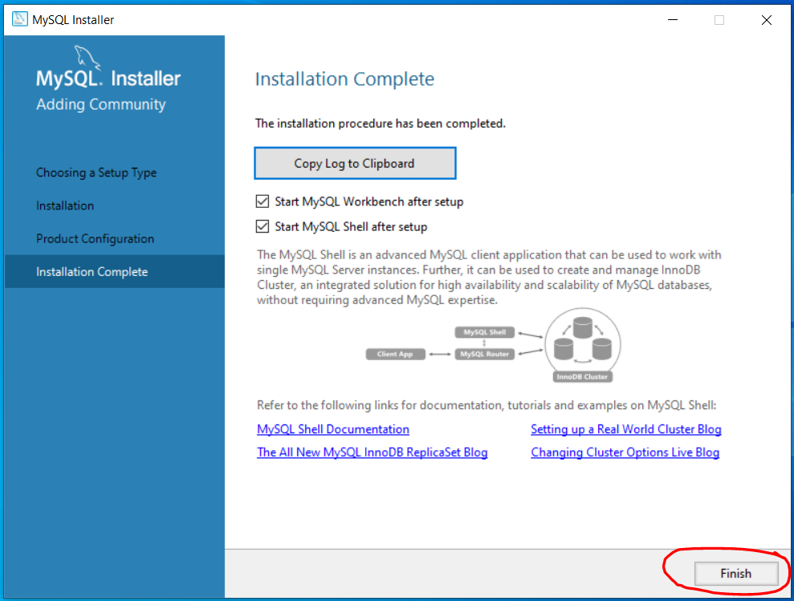
>Click Finish to complete the installationprocess

Slide 30
Voila Installation is complete

Slide 31
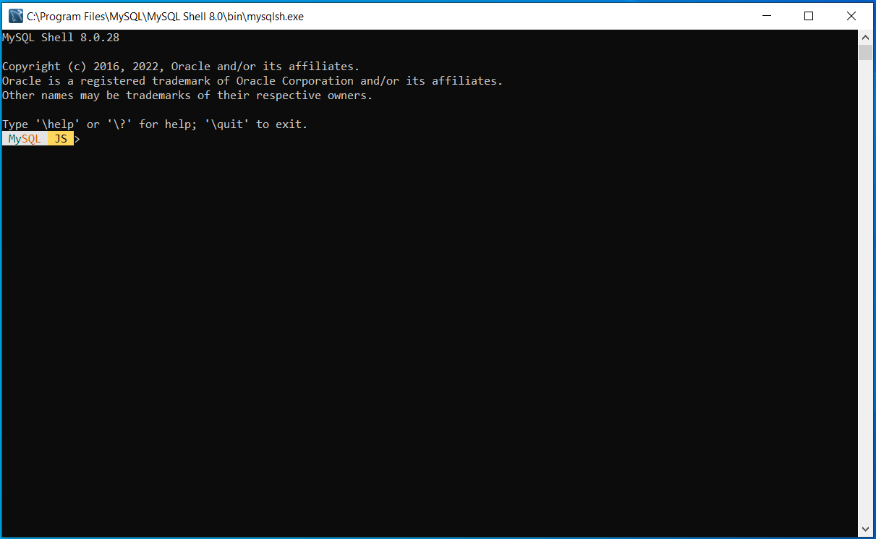
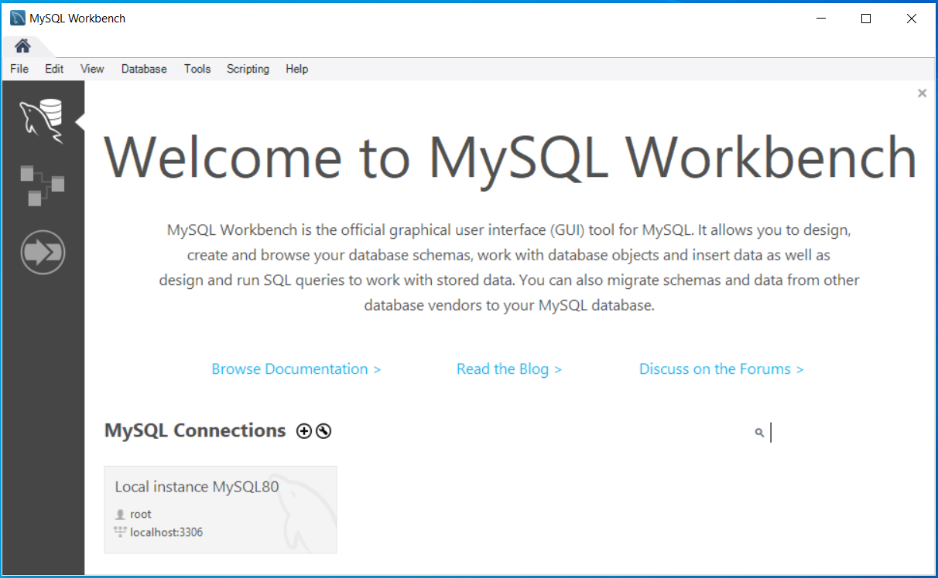
>Upon completion you will see below windows opens for MySQL Workbench and MySQL Shell

Slide 32
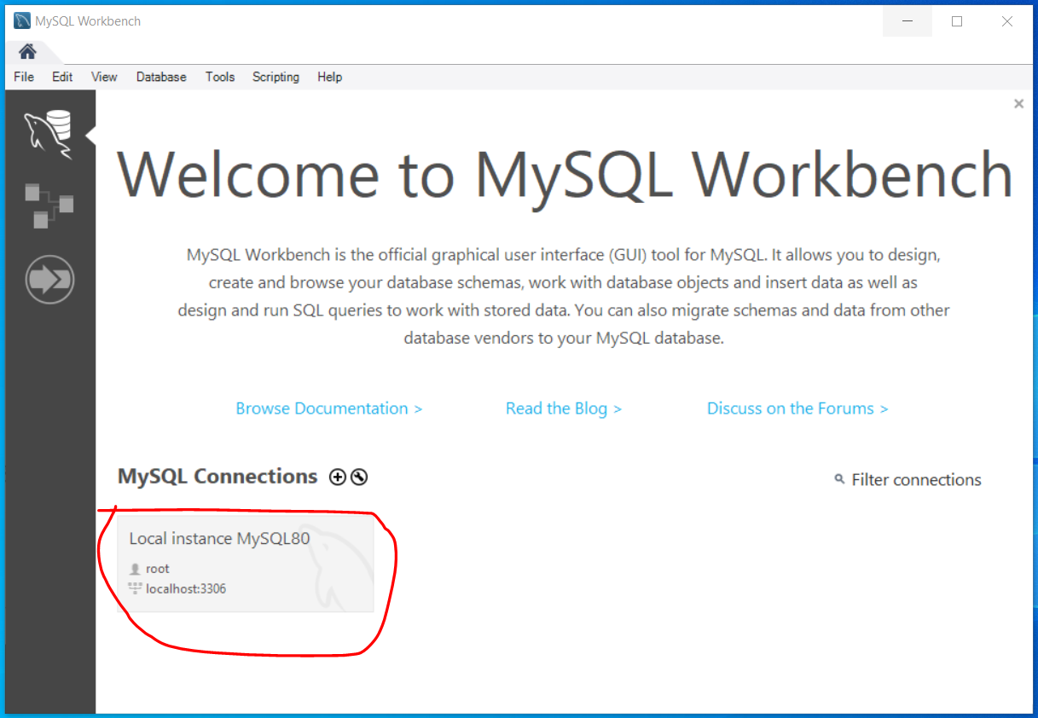
>Double Click on the Local Instance under MySQL Connections to connect to your local DB

Slide 33
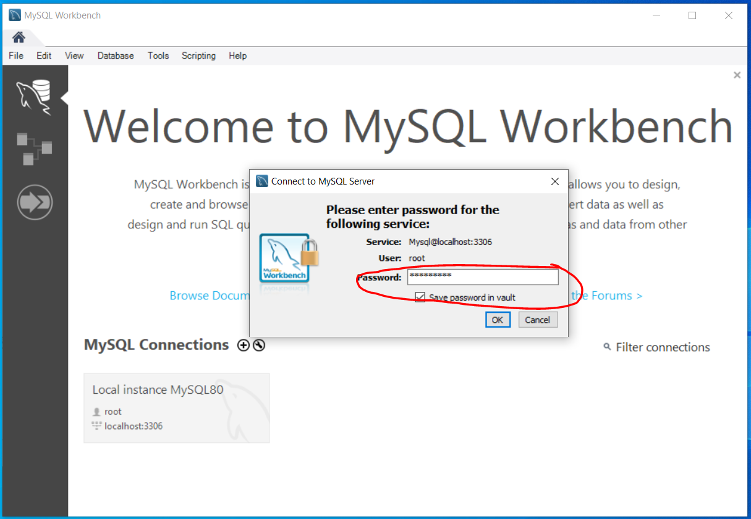
>Enter the password and click OK to connect to your Local DB instance

Slide 34
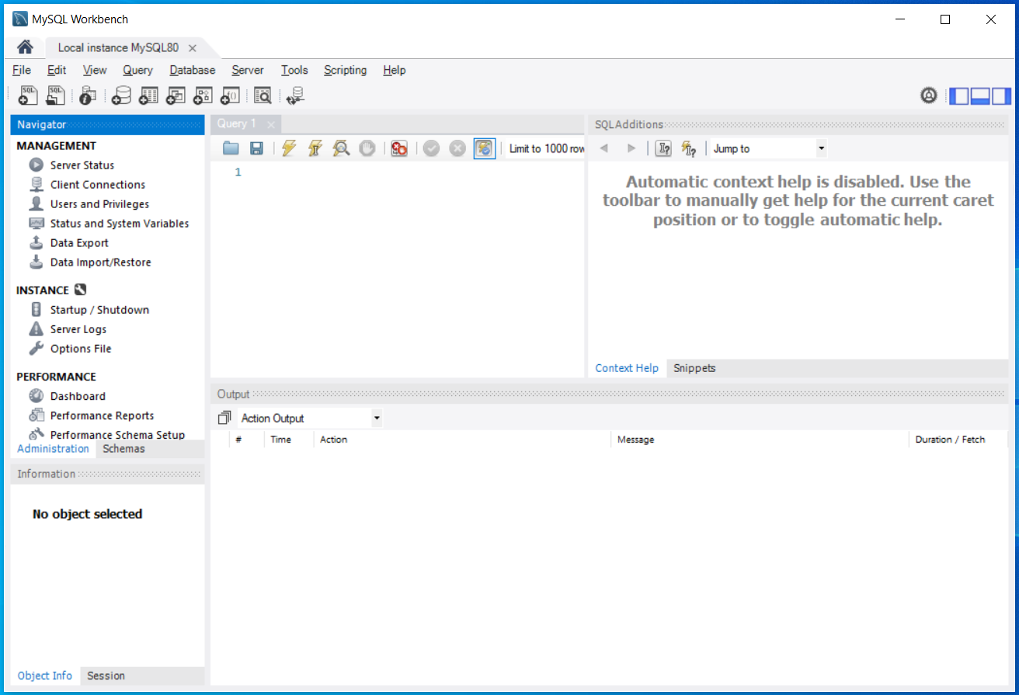
>This is how MySQL Workbench UI looks like >Now, You are ready to start your SQL journey

Slide 35
Reference:
MySQL Website: https://www.mysql.com/
Reference Video: https://www.youtube.com/watch?v=OM4aZJW_Ojs
Github Repo: https://github.com/cbpspratap/SQLTraining
Script to create sample databases:

Slide 36

Thank You

